Slide 1
AIMS Redesign Subcommittee
May 6th, 2024
Full-Committee Meeting

Slide 2
Agenda
Recap
AIMS Website
Template Changes
Additional Metrics
Wording Changes

Slide 3
Recap
Template Changes
Additional Metrics
Wording Changes
April Meeting Recap
CIP Code Length = 6 digits
Add IRB position to Current Administration list
First Time Student Tab = Fall term only
Drop down list for Tribal Affiliation
Part B will remain a separate word doc
Remove Academic Award from Outside Institution from Student Activities

Slide 4
Recap
Template Changes
Additional Metrics
Wording Changes
AIMS Website
Volunteers to explore and provide feedback?
Issues with providing TCUs with redesign committee materials?
Change Log
In Progress Codebook
Slides

Slide 5
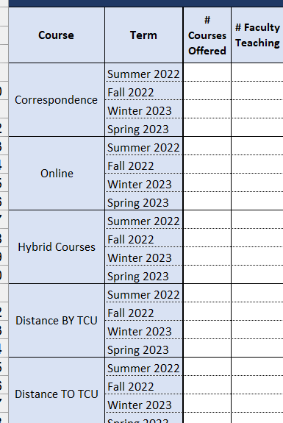
Recap
Template Changes
Additional Metrics
Wording Changes
Codebook Working Group Proposed Changes
Changes to Distance Learning Tab:
Items to Remove
Distance TO TCU
Distance BY TCU
# of Courses Offered
# of Faculty Teaching
Categories to Add:
Face to Face
Course Sharing
Partnering institution type (e.g., other TCU, state institution, etc.)
Subjects of courses shared
Combine Distance Learning Tab with Course Completion Table
Rename section from “Distance Learning” to “Learning Modalities”

Slide 6
Recap
Template Changes
Additional Metrics
Wording Changes
Annual Survey
Identify which sections should be duplicated vs. unduplicated numbers

Slide 7
Recap
Template Changes
Additional Metrics
Wording Changes
Annual Survey
Identify which sections should be duplicated vs. unduplicated numbers
Student Tribal Affiliation
First Time Student Demographics
General Student Demographics
Financial Resources
Fall Enrollment/Enrollment by Degree Program
Completion
Academic Core
Remedial Development
Distance Learning
Student Activities
Students with Impairments
Fall/Spring Survey: Student Enrollment (with added dual enrolled/dual credit/transfer in students)

Slide 8
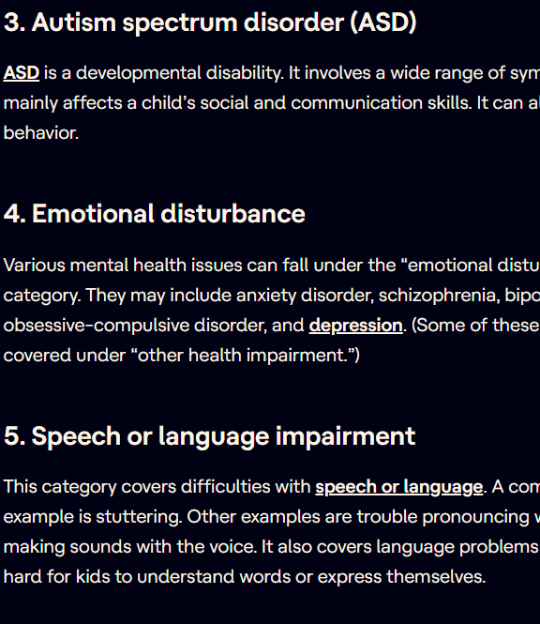
Additional Metrics
Students with Health Conditions/ Impairments Tab
Type of impairment
Individuals with Disabilities Education Act has a list of 13 categories
Accommodations provided by institution
Transfer Student Tab?
Transfer-Out rate
Transfer-In enrollment
Institution transferring from
Incoming credits
Previous Degree Program
Enrolled Degree Program
Demographics?
Recap
Template Changes
Additional Metrics
Wording Changes

Slide 9
Additional Metrics
Anytime Graduation Rate
Unduplicated Headcount by
Degree/Non-Degree Seeking
AI/AN/Non-AI/AN
Student Employment Status (While Enrolled)
Part-Time
Full-Time
Seasonal
Not-Working
Internet Connectivity
ISP Provider
Connectivity Speeds (in Mps)
Annual Internet Costs
Recap
Template Changes
Additional Metrics
Wording Changes

Slide 10
Additional Metrics
International Students:
International Student Enrollment by Visa Type
F-1, J-1, and M-1
Student’s Home Country
Program of Enrollment
Financial Aid offered
Post-graduation employment/future education.
Does TCU have formal relationships with universities abroad?
What countries and universities?
Recap
Template Changes
Additional Metrics
Wording Changes

Slide 11
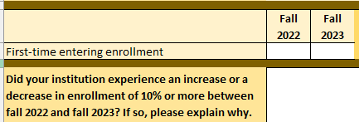
Wording Changes
Annual: First Time Entering -> First Time Ever in College
Fall: First Time Entering -> New to Institution
Recap
Template Changes
Additional Metrics
Wording Changes

Slide 12
Wording Changes
Annual: # of Courses in which students enrolled/completed -> Total Course Enrollment/Total Successful completers
Recap
Template Changes
Additional Metrics
Wording Changes

Slide 13
Next Steps
Codebook and Qualtrics Translation Working Group Meetings
Next Month’s Focus:
Freeze Date/Census Discussion
PDP Overlap

